Slide 1
Case 1: Conditions for Improving Performance: Evidence for Suggestibility in ‘Slow’ Environments. Case 2: The Effect of Residential Integration on Voting Outcomes in the 2016 UK Referendum
Derek Lukacsko

Slide 2
Conditions for Improving Performance: Evidence for Suggestibility in ‘Slow’ Environments Derek Lukacsko – IESE Business School, department of Information Systems

Slide 3
Agenda
motivation - identifying the problem
hypotheses
methodology
results and inferences
Notes:
Accounts (Thaler 1991)

Slide 4
Motivation: Self-reinforcing Environments
Recognizing that scientific endeavors are themselves anchored to their premises and likely find theoretical support where attention is given (Miller, 2001; O’Mahony & Ferraro, 2005), theories of decision-making are likely to affect the manifest decision-making they attempt to objectively assess. Do we see a similar effect on tried and tested objective decision-making tasks based simply on how decision-making is framed, i.e. as a either a virtue or vice?
Notes:
Accounts (Thaler 1991)

Slide 5
Motivation: Models of Decision-Making
Homo Economicus: model of self-sufficient man whose sole desire is to obtain wealth
Bounded Rationality: effective search for alternatives depends on aspiration levels and environmental contingency
Effectiveness in given environment (Giggerenzer, Hogarth, et al.)
Prospect theory: effectiveness relative to a reference point
System 1 and 2 (Kahneman 2003, 2011)
Given the growing influence of prospect theory (i.e. behavioral economics, behavioral finance, marketing etc.), do its hypotheses influence manifest decision-making?
Notes:
Accounts (Thaler 1991)

Slide 6
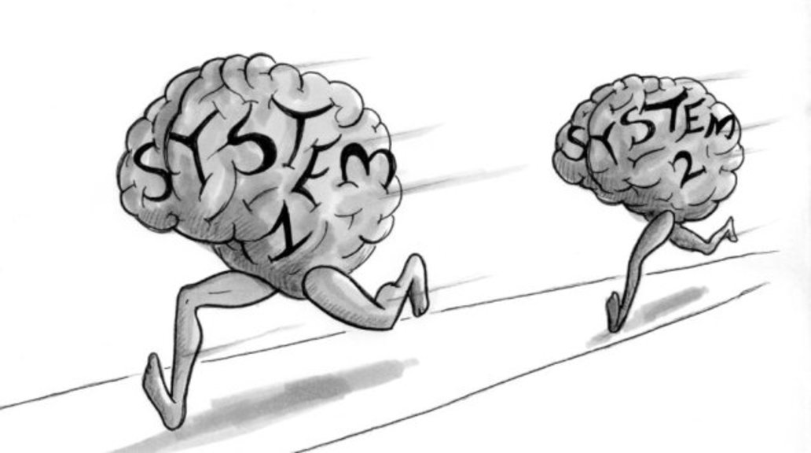
Notes:
Accounts (Thaler 1991)

Slide 7

Notes:
Accounts (Thaler 1991)

Slide 8


Notes:
Accounts (Thaler 1991)

Slide 9
Notes:
Accounts (Thaler 1991)

Slide 10

Notes:
Accounts (Thaler 1991)

Slide 11


Notes:
Accounts (Thaler 1991)

Slide 12


 | Speed
 | -
 | -
Thinking Fast
Thinking Slow
Notes:
Accounts (Thaler 1991)

Slide 13
 | Speed | Accuracy
 | - | -
 | -
 |  | -
Thinking Fast
Thinking Slow
Notes:
Accounts (Thaler 1991)

Slide 14
Methodology
Experiment setup:
MTurk
4 groups, 15 participants each
10 multiple-choice IQ questions
Incentives: pay per question, attention check
Compiling data in Rmarkdown:
loading csvs, create dataframes, reshape, remove columns, typecast, repeat for two conditions (accuracy and speed)
Hypothesis testing: Kruskal Wallace test of means
Display results: render boxplots
Notes:
Accounts (Thaler 1991)

Slide 15
Example Treatment
Research has shown that research subjects can solve complex problems using simple rules of thumb or cognitive heuristics. Though research subjects are often unaware of their heuristics, scientists remain interested in determining how they affect performance in reasoning tasks. You have 20 minutes to complete 10 reasoning questions. Payment will be made for each correct answer. There will be one attention check question. Payment will only be made to individuals who pass the attention check.
Notes:
Accounts (Thaler 1991)

Slide 16
Example Question
Boris and Ben share bus passes in the ratio of 3 : 5. If Boris has 180 bus passes, how many does Ben have?
260
300
240
340
320

Slide 17
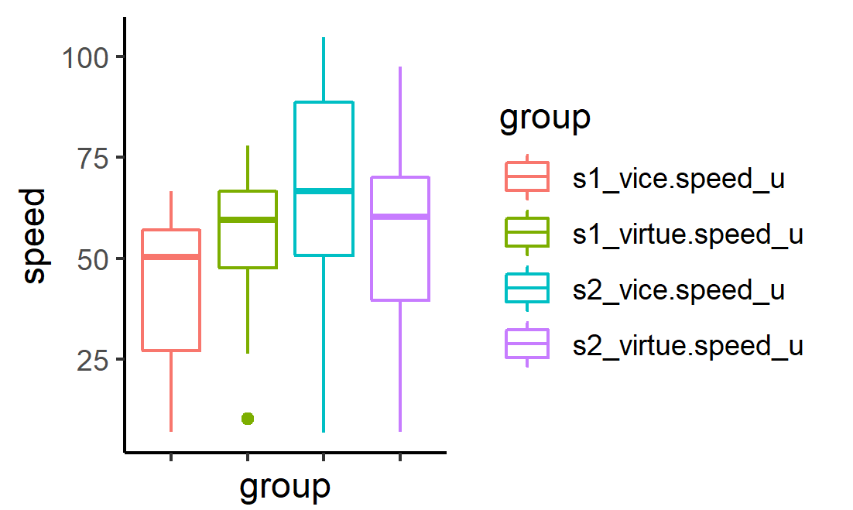
 | Speed
 | -
 | -
Notes:
Accounts (Thaler 1991)

Slide 18
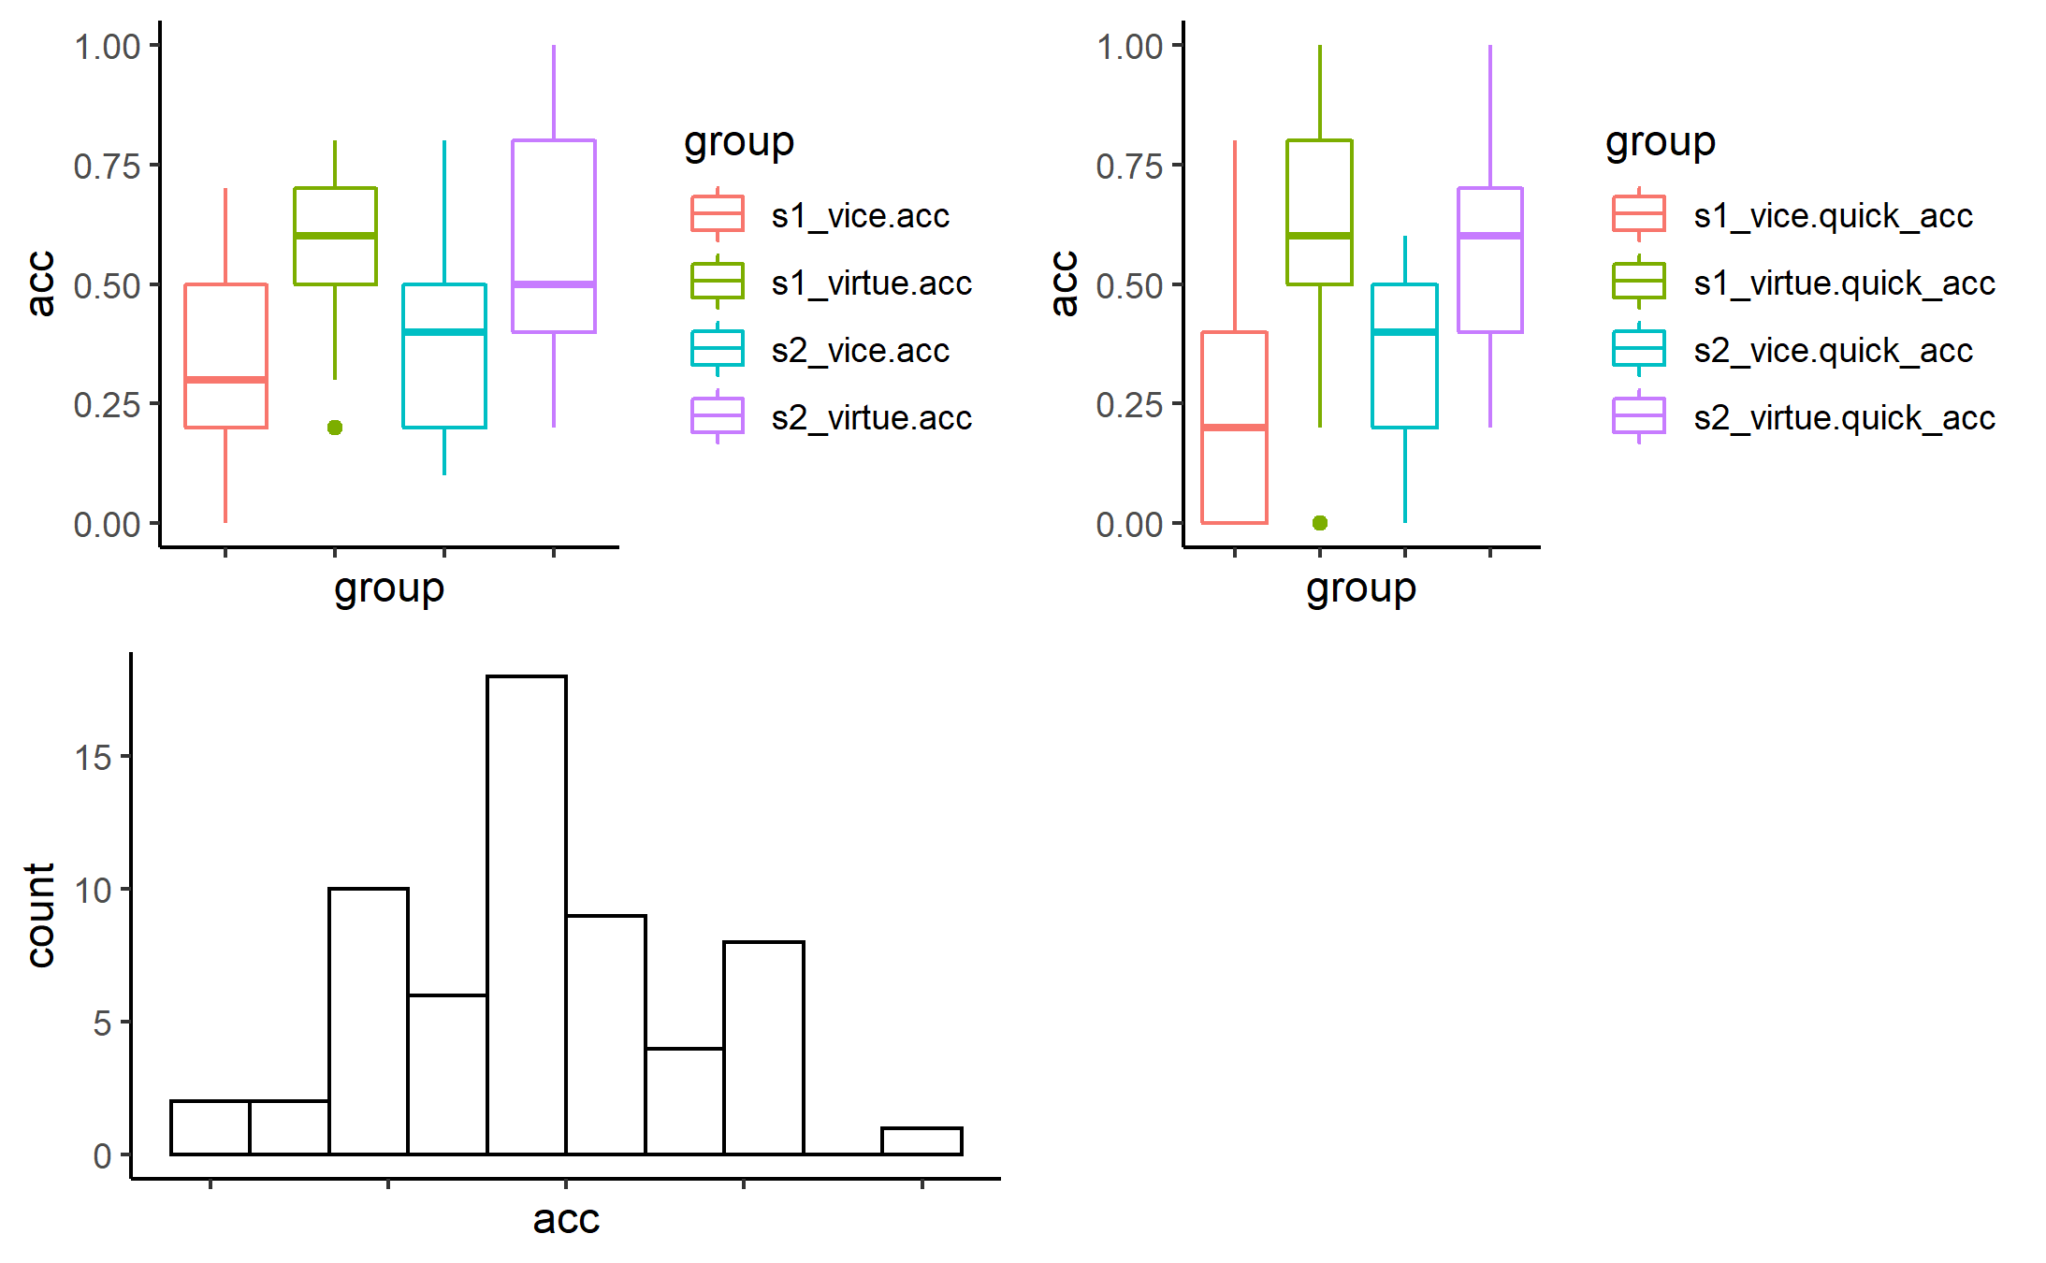
 | Accuracy
 | -
 | -
Notes:
Accounts (Thaler 1991)

Slide 19
 | Accuracy
 | -
 | -
Notes:
Accounts (Thaler 1991)

Slide 20

 | Speed | Accuracy
 | - | -
 | -
 |  | -
Notes:
Accounts (Thaler 1991)

Slide 21
Implications
Before we can solve complex problems, we need to understand how to cultivate empowering environments
Potential of an extension of the experiment in live settings to help organizations assess team morale, i.e. IQ test as a collective measure of team morale rather than individual competency

Slide 22
The Effect of Residential Integration on Voting Outcomes in the 2016 UK Referendum Derek Lukacsko – IESE Business School, department of Information Systems Jonathan Bourne – University College London, Energy Institute

Slide 23
There was a sense of shock and disbelief in the early morning hours of 24 June 2016, both in Britain and across European capitals, when it became clear that a small majority (51.9 per cent) of British voters had cast their ballot in favor of leaving the European Union (Hobolt 2016). Discussion in the aftermath mostly focused on the uneducated poor vs the metropolitan elite and the influence of historical British nationalism…

Slide 24
Preview of Result
…We take a different approach looking at whether communities where the White-British and non-White British (Asian, Polish, etc.) populations are highly integrated tended to increase or decrease the likelihood of voting out. At the extreme ends, 10 out of 10 of the most segregated local authority districts voted out whilst 6 of the 10 most integrated voted in. Net-net, more residential integration reduces the probability of voting out.

Slide 25
Agenda
What is residential integration?
How does integration relate to Brexit voting outcomes?
Does integration explain Brexit voting outcomes better than other explanations?
Summary

Slide 26
Agenda
What is residential integration?
How does integration relate to Brexit voting outcomes?
Does integration explain Brexit voting outcomes better than other explanations?
Summary

Slide 27
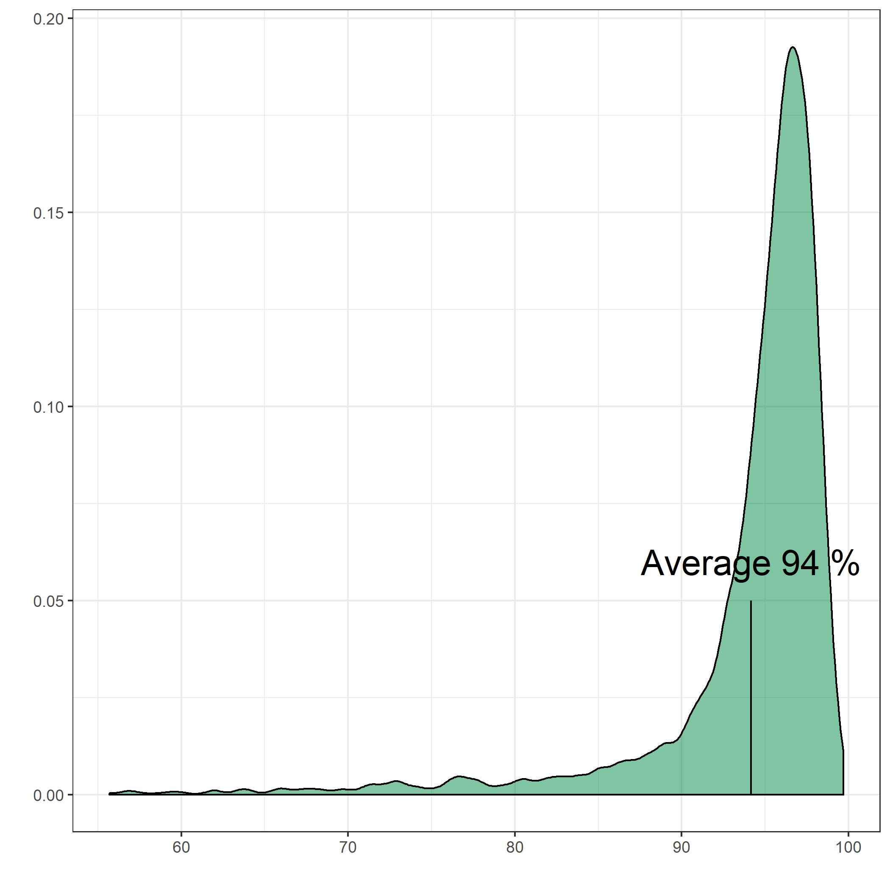
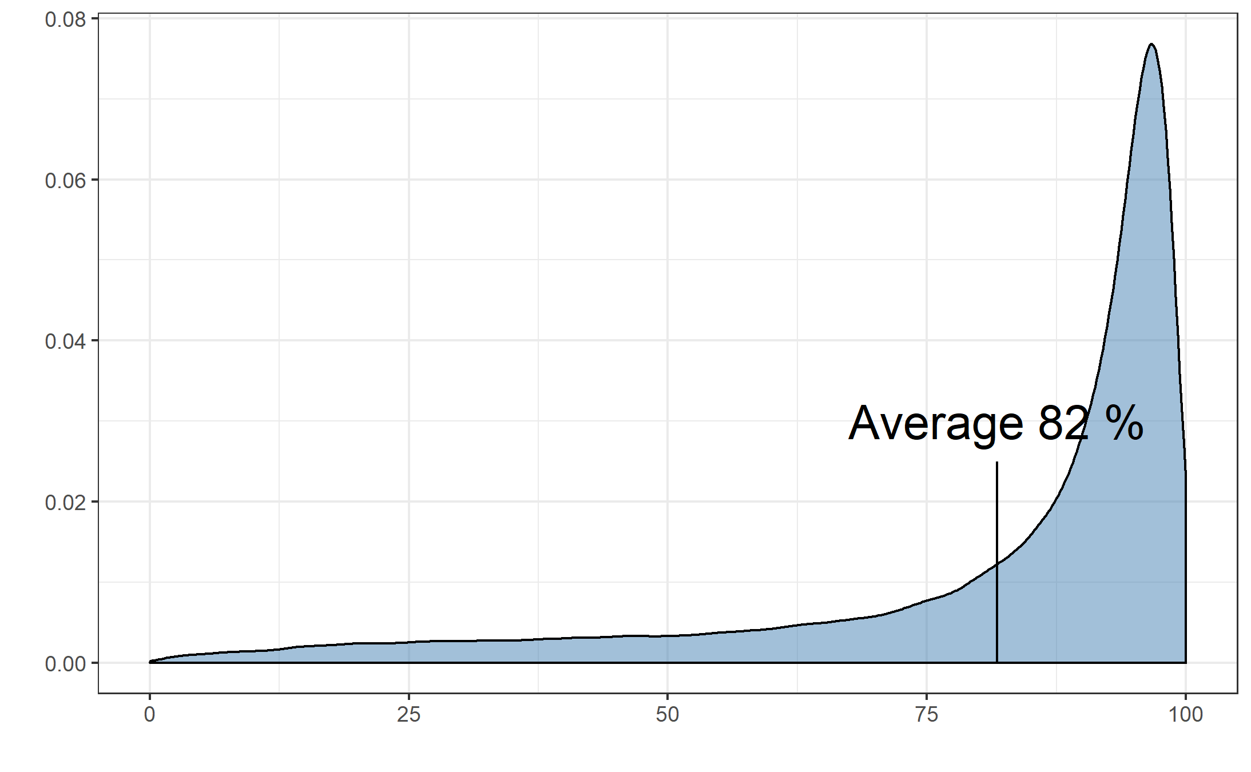
Percentage of White British by Neighborhood (n=184,470)
Scotland
England & Wales

Slide 28
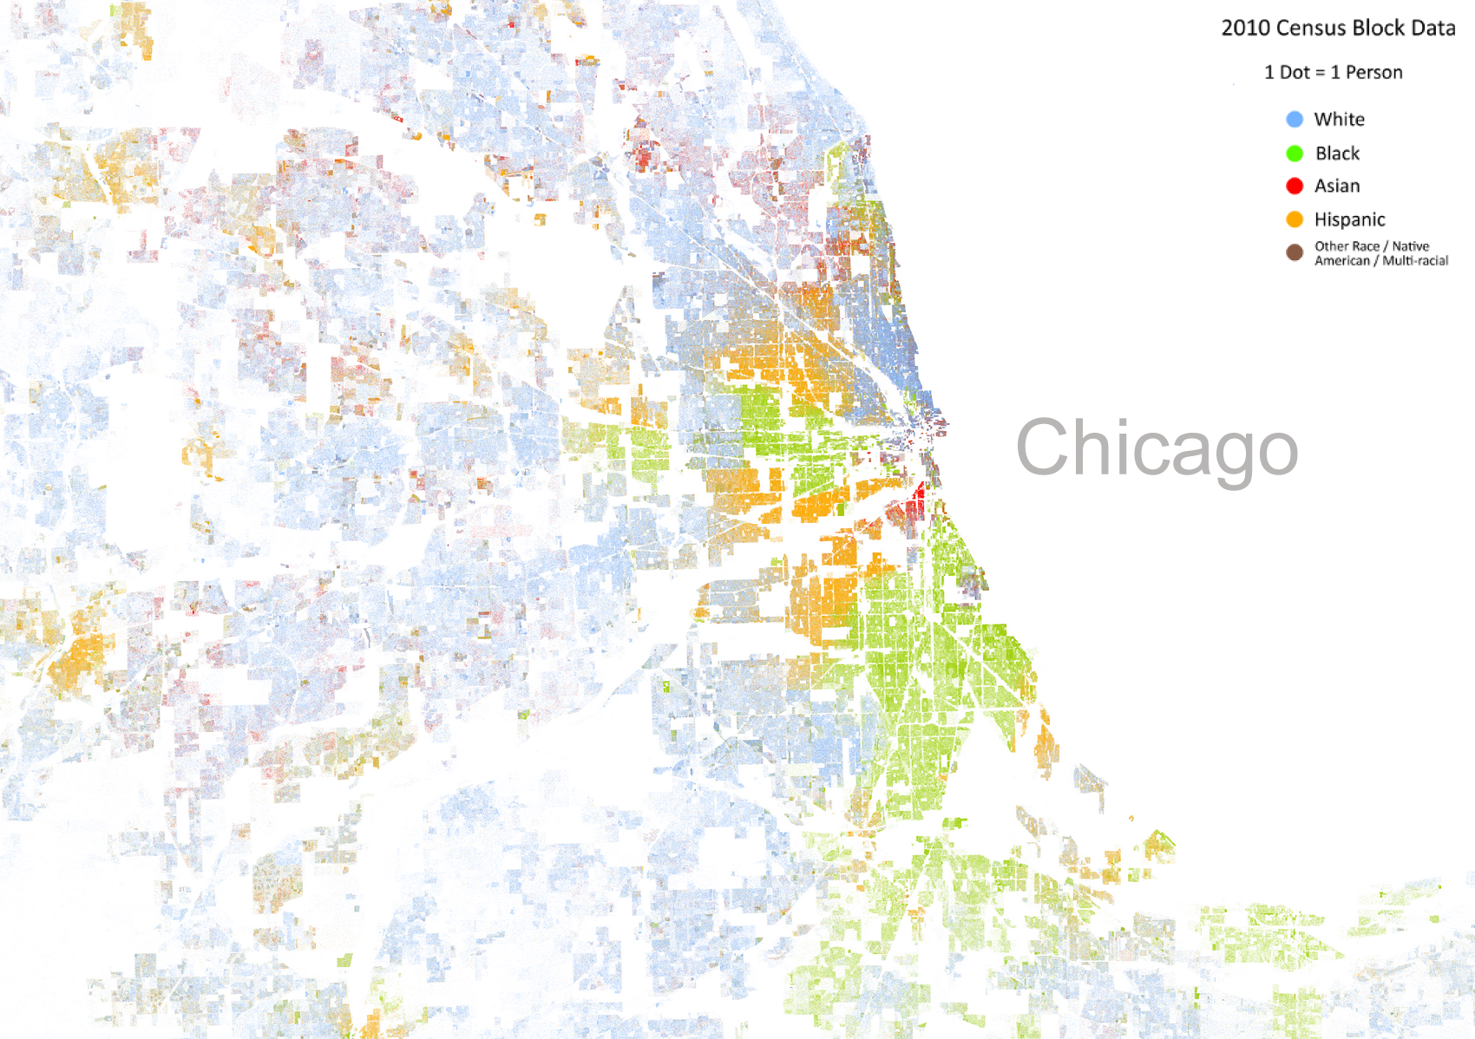

is a diverse city overall…
Source: https://fivethirtyeight.com/features/the-most-diverse-cities-are-often-the-most-segregated/

Slide 29
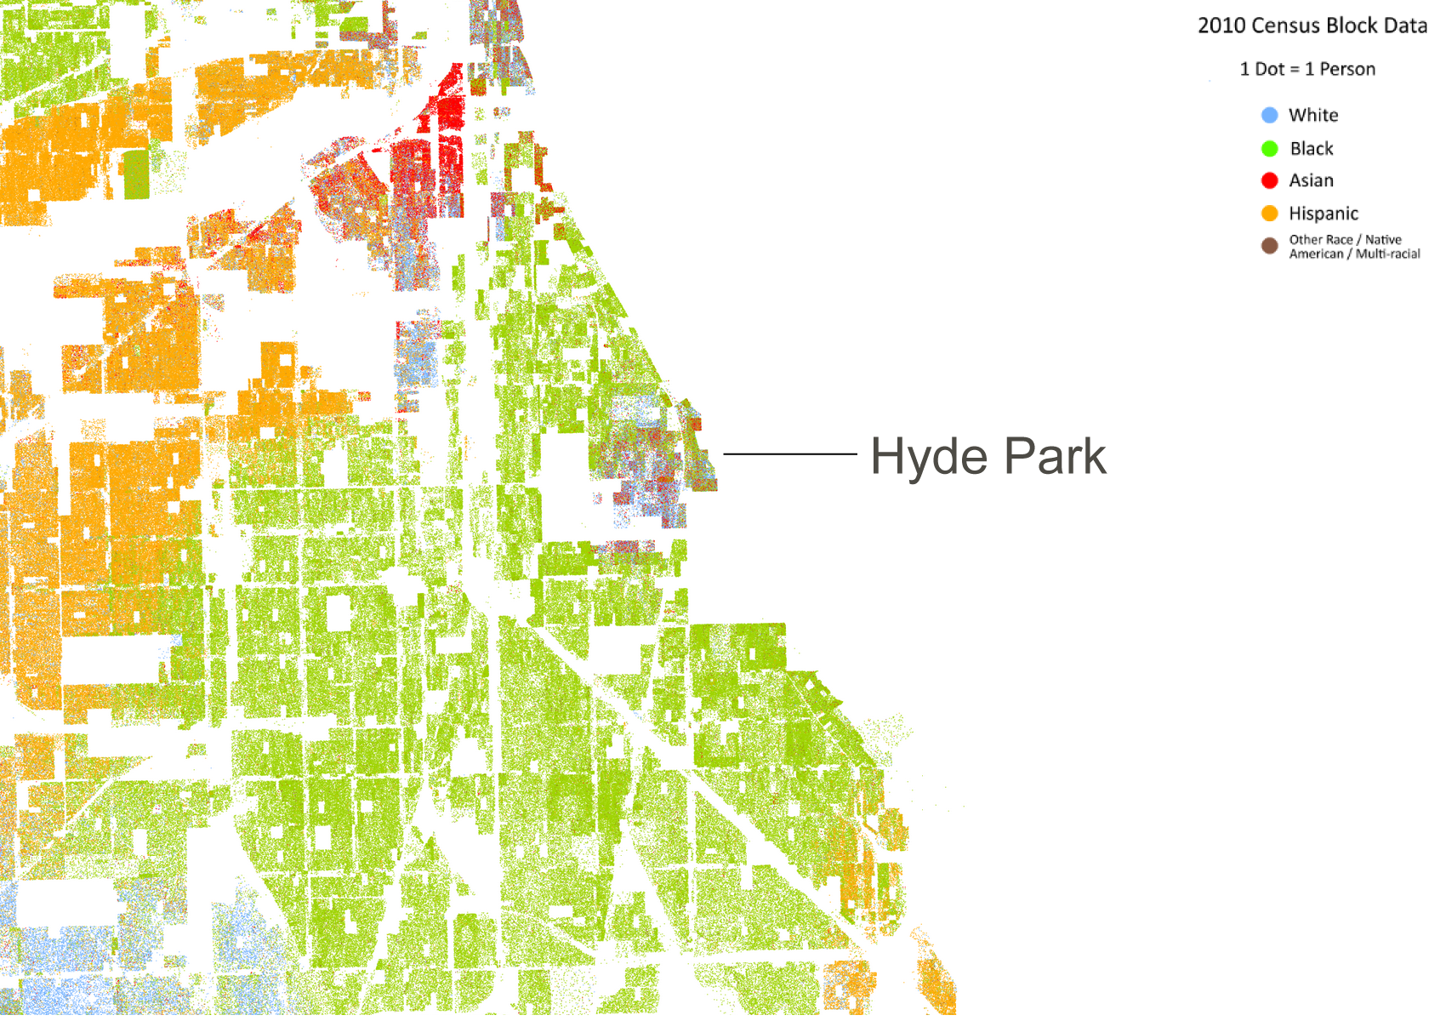
… but its neighborhoods are segregated
Source: https://fivethirtyeight.com/features/the-most-diverse-cities-are-often-the-most-segregated/

Slide 30
is diverse but segregated i.e., it
underachieves its potential to integrate its population
Source: https://fivethirtyeight.com/features/the-most-diverse-cities-are-often-the-most-segregated/

Slide 31
Key Terms
Local Authority District (LAD) | High-level geographic area with populations 20,000 - 200,000. (n = 382: 326 England, 32 Scotland, 22 Wales, 1 Northern Ireland, 1 Gibraltar)
Output Authority (OA) | Low level geographic area with populations ~125. (171,372 England; 46,351 Scotland; 10,036 Wales; NI & Gilbraltar …)
LAD Diversity | What percent of the people belong to a different racial group? [0,0.5].
OA Diversity | For an average resident in the LAD, what percent of the people in her neighborhood belong to a different racial group? [0,lim(DD)]
Integration | The extent to which a borough is composed of neighborhoods on average more diverse than the expected level of neighborhood diversity.

Slide 32
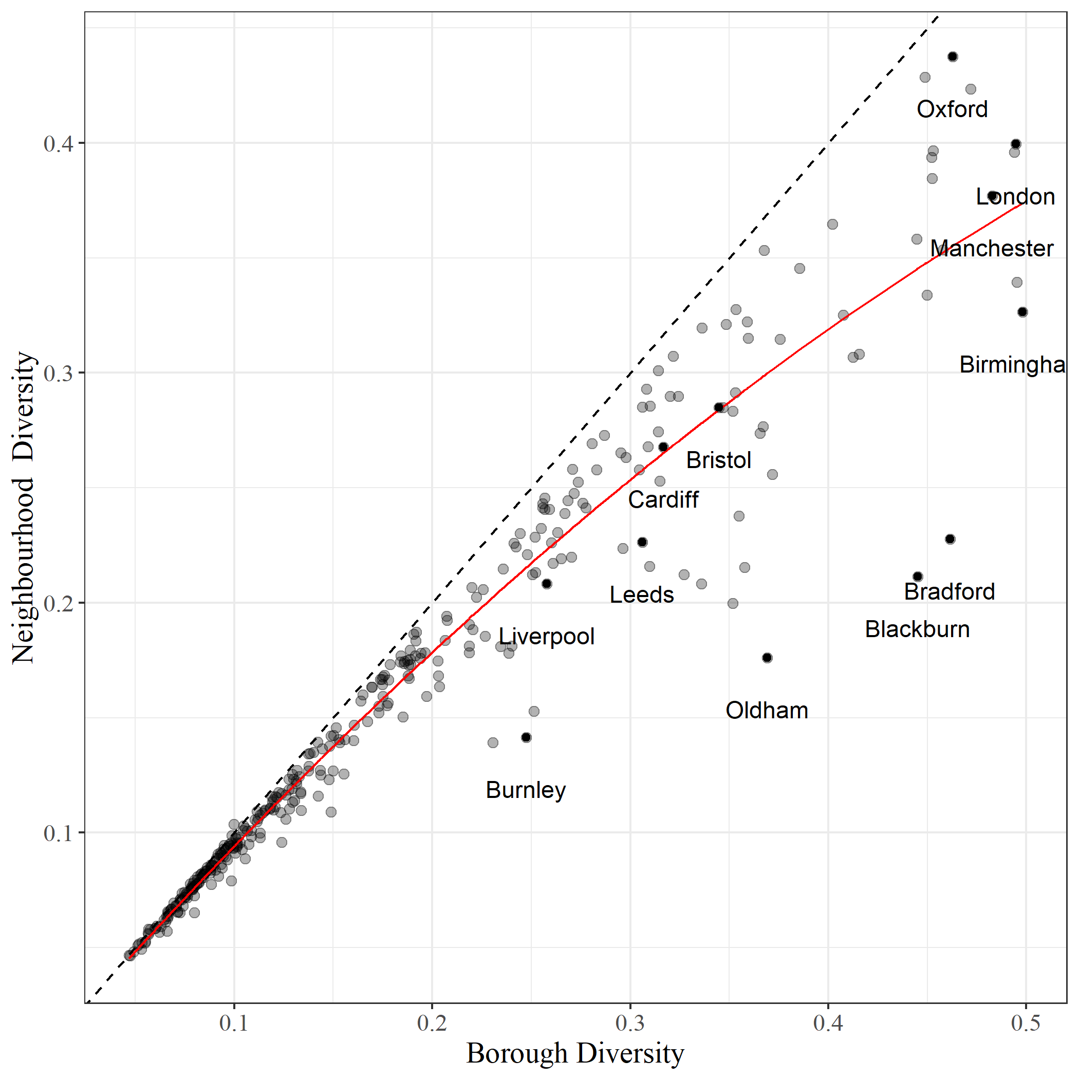

Integration : how far does the diversity of surrounding neighborhoods differ from LADs with similar overall diversity?
Laredo TX,
Scottsdale AZ,
etc.
LAD Diversity

Slide 33
Agenda
What is residential integration?
How does integration relate to Brexit voting outcomes?
Does integration explain Brexit voting outcomes better than other explanations?
Summary

Slide 34
Other explanations:
Paper | Contributors | Data
(Goodwin et al. 2016) | Voter turnout, 2014 UKIP vote, education, age, and percent non-white | 2011 UK Census
(Becker et al. 2017) | Education, migration, unemployment, outstanding mortgage, weather | 2011 UK Census
(Ingleart et al. 2016) | Populism, generational backlash rather than economic insecurity | 2014 Chapel Hill Expert Survey, political party
(Hobolt 2016) | Less-educated, poorer, older voters | Panel survey leading up to the referendum
(Becker et al. 2017) | Age and economic inequality | None
(Sampson 2017) | Populism | NA

Slide 35
LAD Diversity

Slide 36
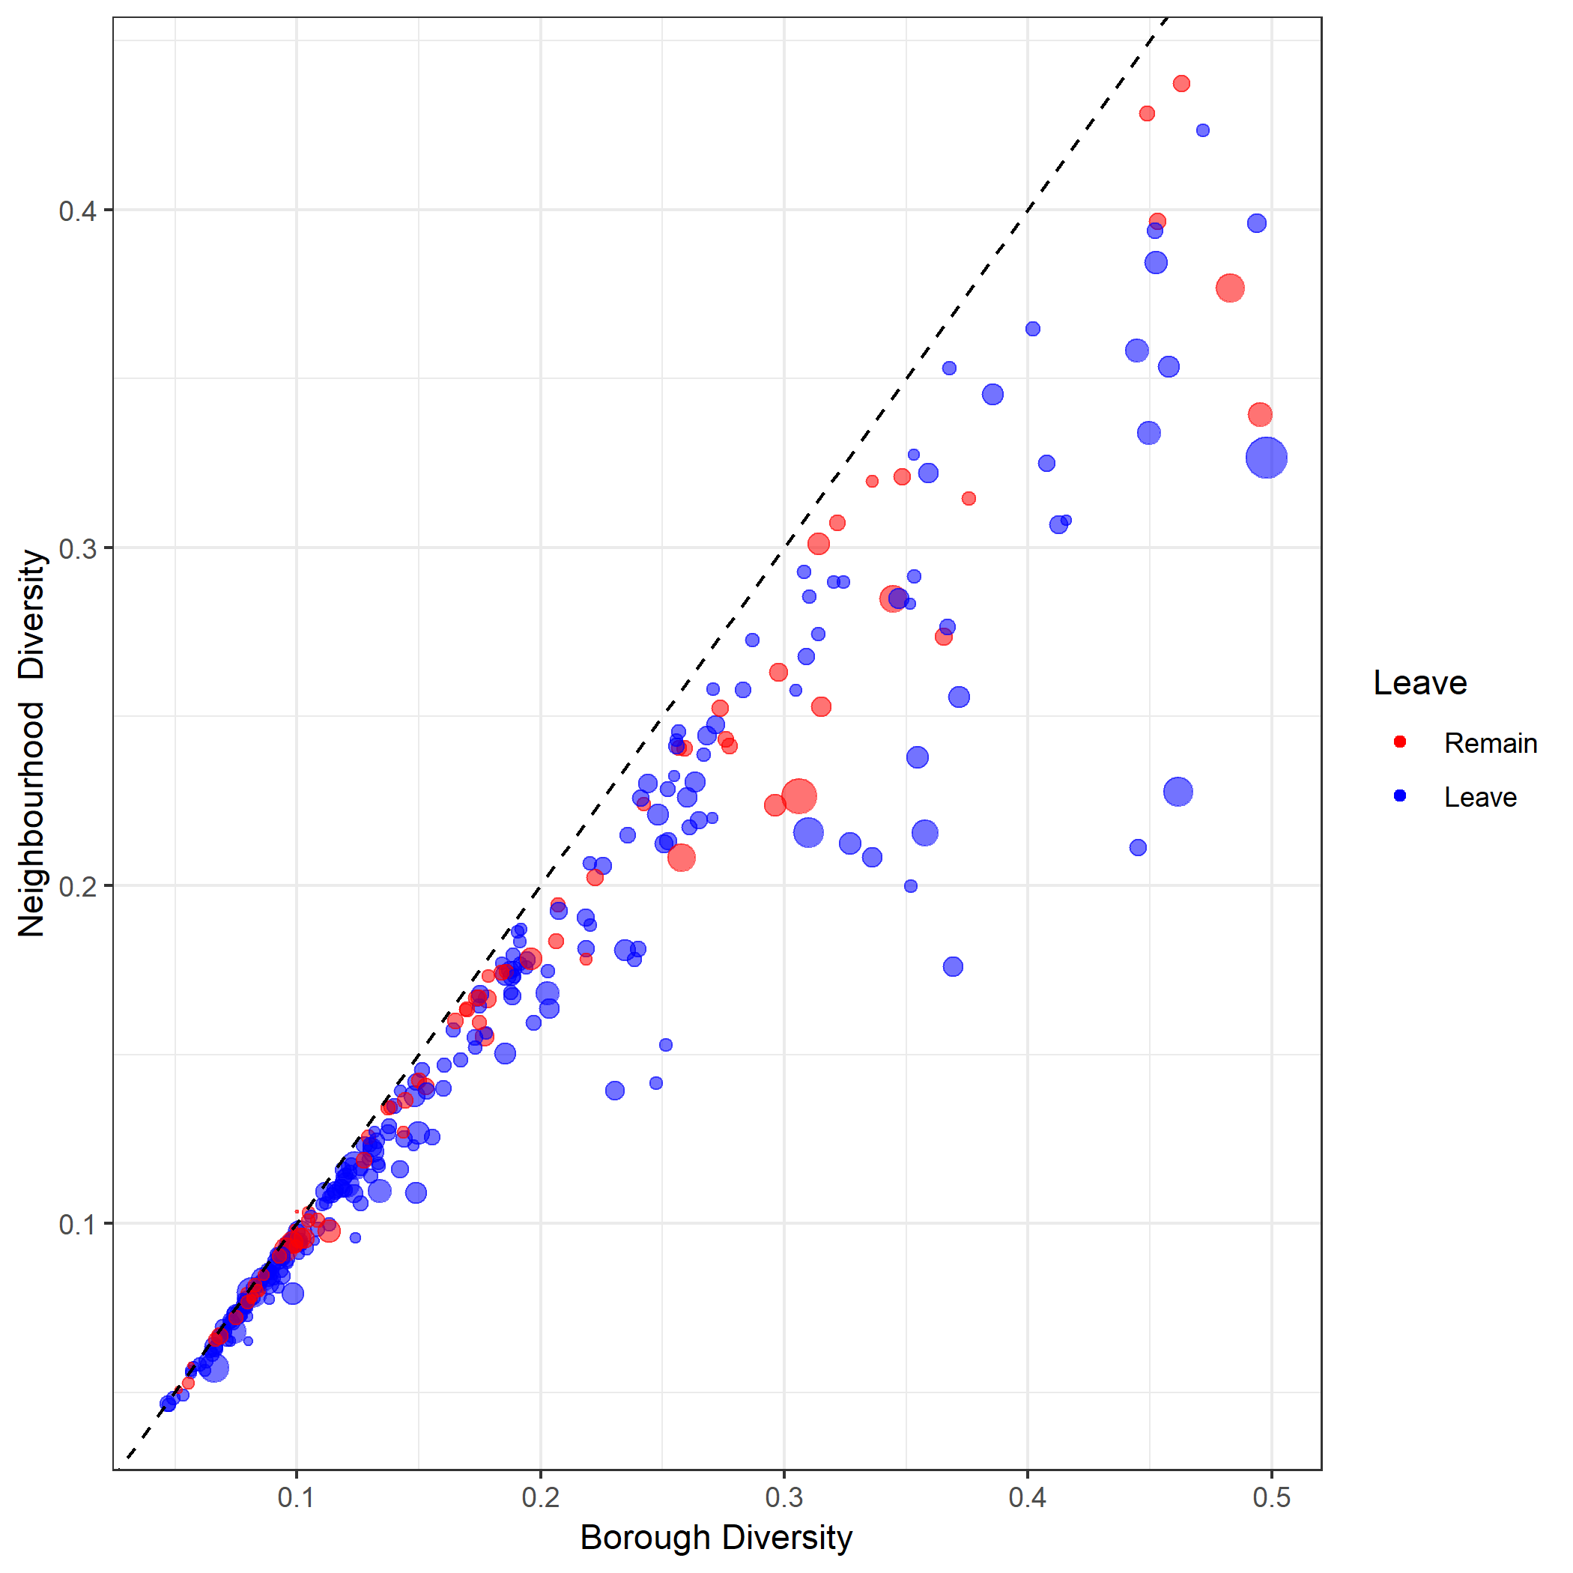
Voting
Outcomes:
LAD Diversity

Slide 37
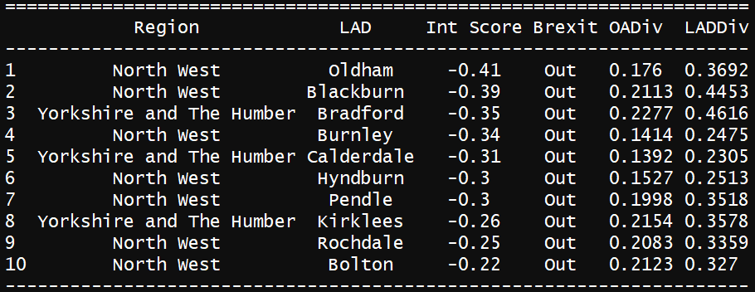
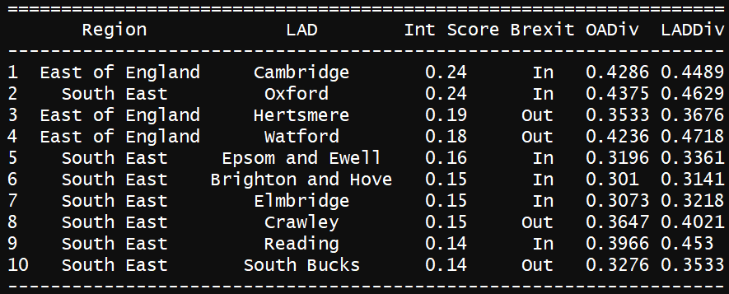

Slide 38
Agenda
What is residential integration?
How does integration relate to Brexit voting outcomes?
Does integration explain Brexit voting outcomes better than other explanations?
Summary

Slide 39
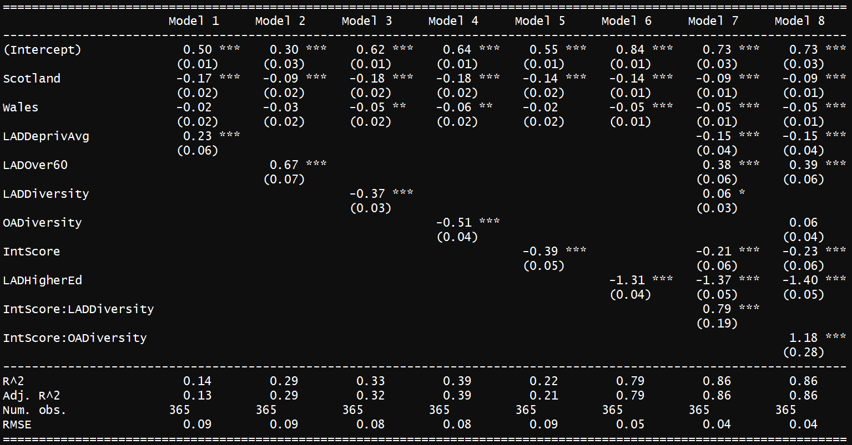
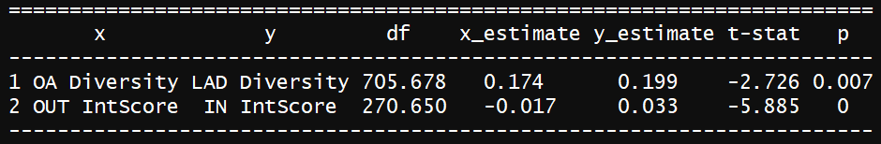

Slide 41
Agenda
What is residential integration?
How does integration relate to Brexit voting outcomes?
Does integration explain Brexit voting outcomes better than other explanations?
Summary

Slide 42
Summary
Common explanations for the Brexit outcome didn’t account for residential diversity
When diversity is considered in absolute terms, it fails to account for the context

Slide 43
Summary
Common explanations for the Brexit outcome didn’t account for residential diversity → Brexit ~ residential diversity
When diversity is considered in absolute terms, it fails to account for the context → Brexit ~ residential integration

Slide 44
Summary
Common explanations for the Brexit outcome didn’t account for residential diversity → Brexit ~ residential diversity
When diversity is considered in absolute terms, it fails to account for the context → Brexit ~ residential integration
Result:
Education attainment remains the dominant explanation (see next slide).
More integrated regions were less likely to vote out.
Aggregate diversity was not relevant when taking residential integration into account

Slide 45
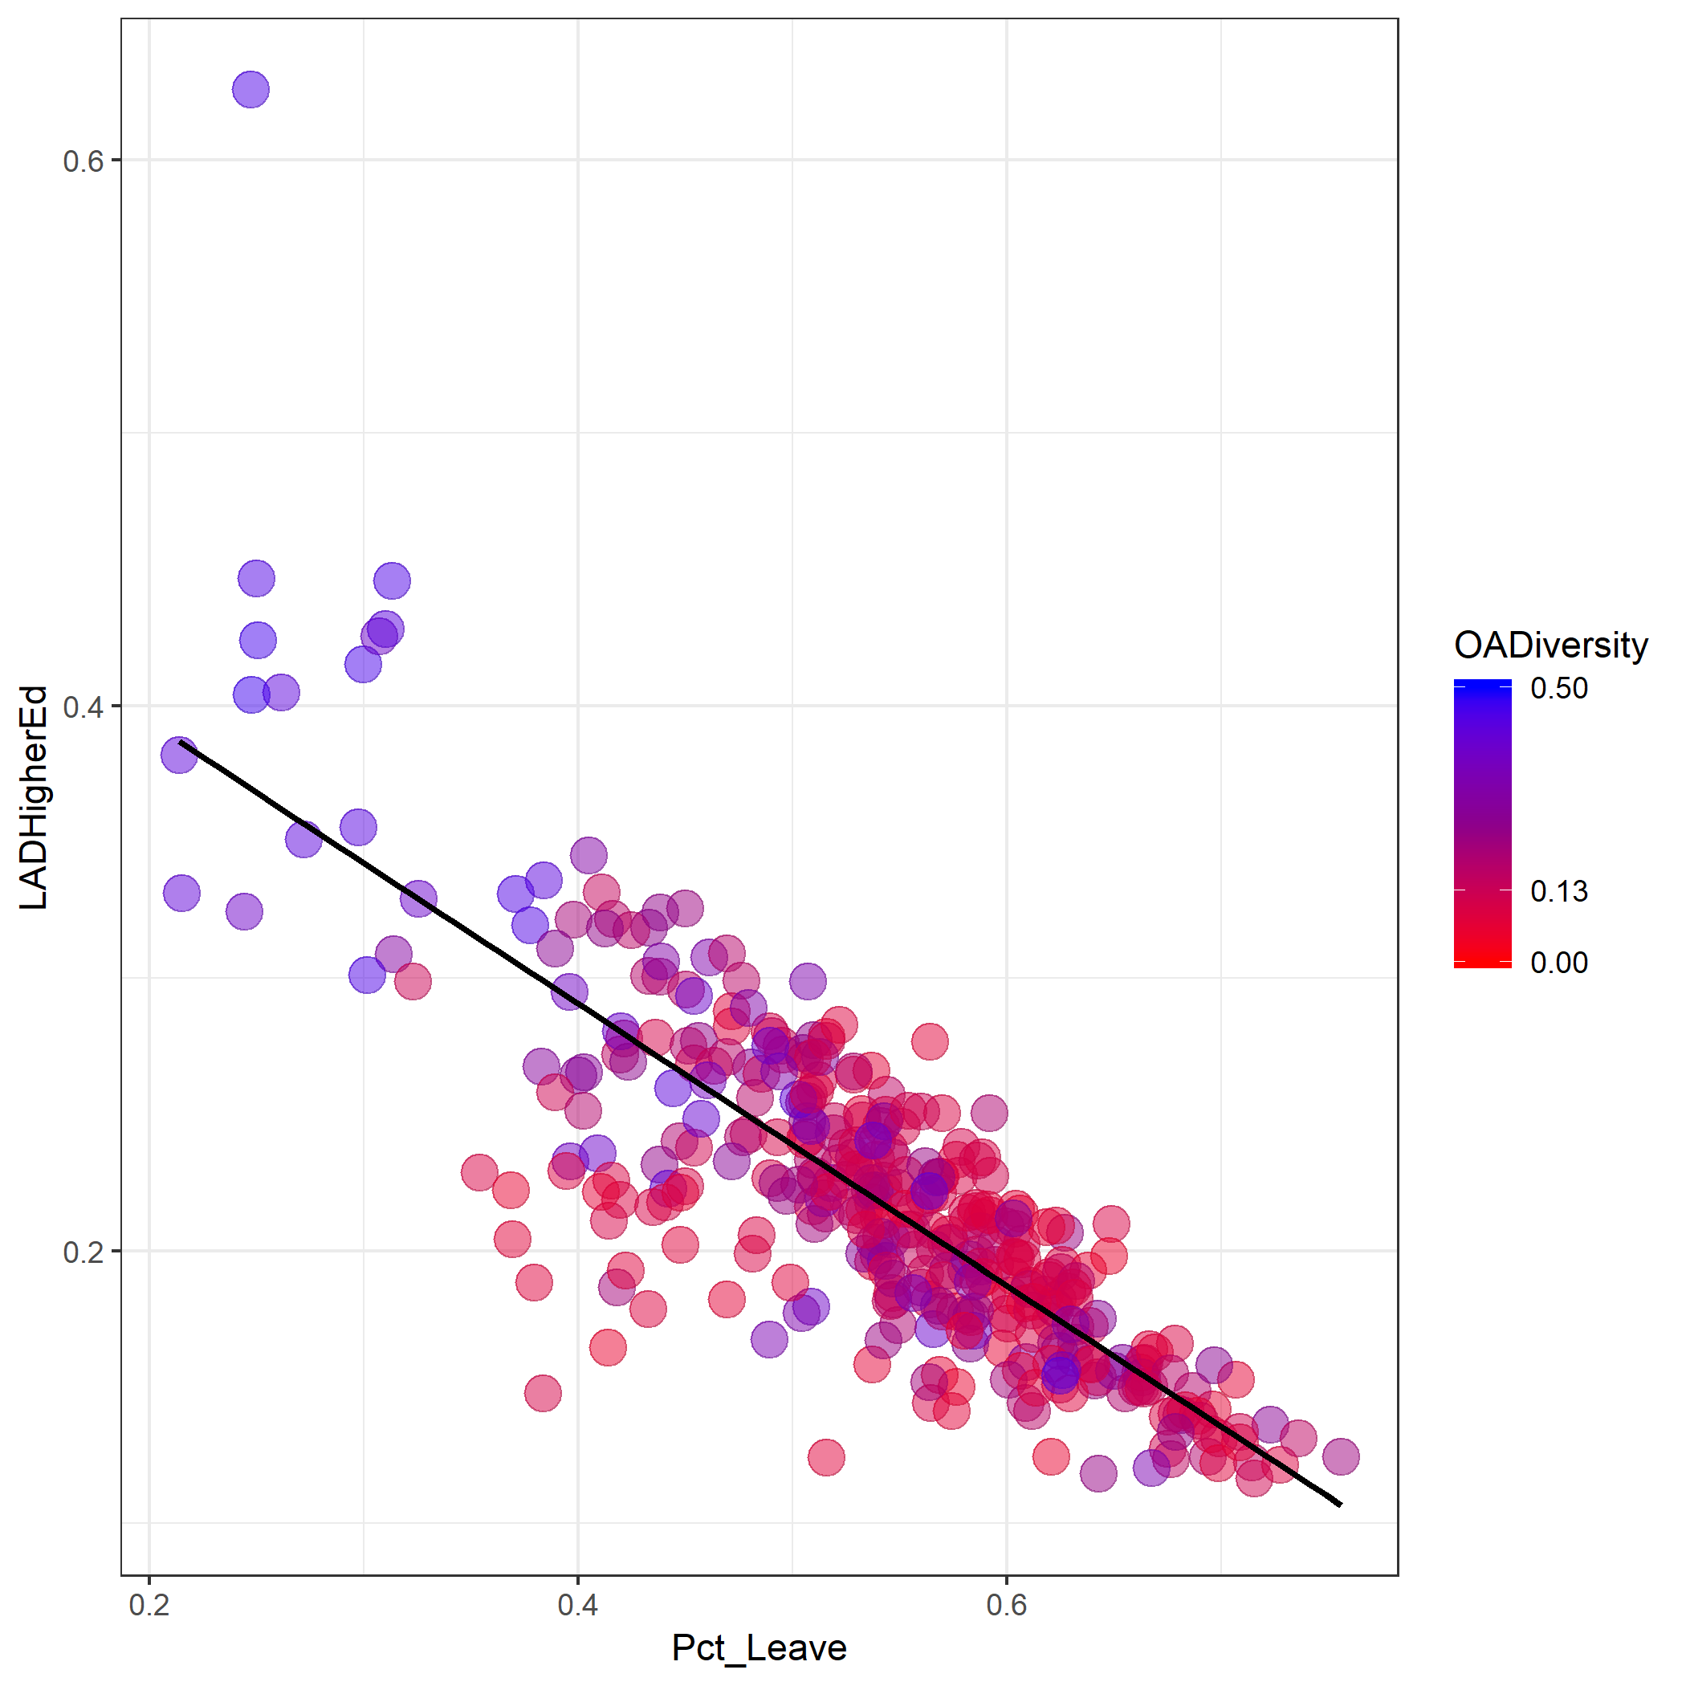

Slide 46
Summary
Result:
Education attainment remains the dominant explanation (see next slide).
More integrated regions were less likely to vote out.
Aggregate diversity was not relevant when taking residential integration into account
Takeaway: Brexit took us by surprise. Given these results, we conclude that segregation is a serious issue for the UK that can create mistrust between communities and that increasing levels of residential integration should be of concern to policy makers and local government. By learning what may have driven the result, policy makers may be in a better position to plan for similar future scenarios.

Slide 47
Etc.

Slide 48
Methodology
Data used:
UK Statistics Authority (https://www.nomisweb.co.uk/)
Brexit votes (http://www.electoralcommission.org.uk/)
Scotland data (multiple sources)
Primary ETL steps:
remove, standardize, typeset, and join tables, repeat for Scotland data
join UK with Scotland data
aggregate neighborhood fields to borough level, summarize fields
calculate integration measure
create plots and tables
perform hierarchical linear regression
Packages used: core tidyverse, stargazer
Rendered in RMarkdown (300 lines, 5 chunks)

Slide 49
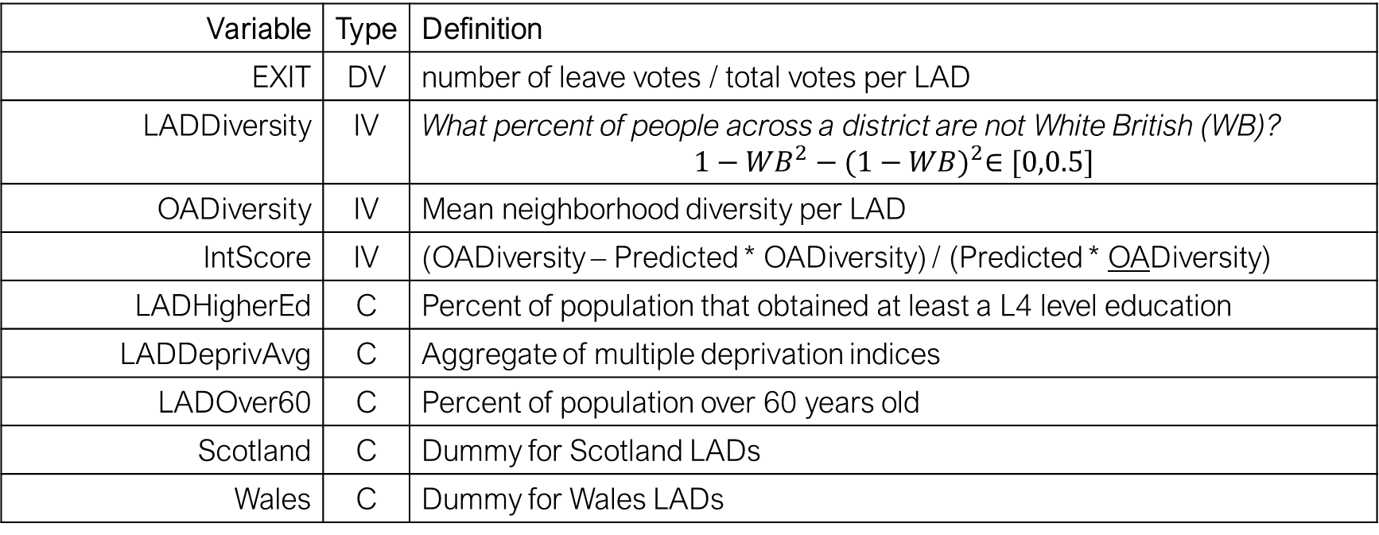
Variables used in OLS
Variable | Type | Definition
EXIT | DV | number of leave votes / total votes per LAD
LADDiversity | IV | What percent of people across a district are not White British (WB)? $$1−{WB}^{2}−{(1−WB)}^{2}∈[0,0.5]$$
OADiversity | IV | Mean neighborhood diversity per LAD
IntScore | IV | (OADiversity – Predicted * OADiversity) / (Predicted * OADiversity)
LADHigherEd | C | Percent of population that obtained at least a L4 level education
LADDeprivAvg | C | Aggregate of multiple deprivation indices
LADOver60 | C | Percent of population over 60 years old
Scotland | C | Dummy for Scotland LADs
Wales | C | Dummy for Wales LADs
*Model: OADiversity ~ LADDiversity + LADDiversity^2

